Slide 1
SESSION 4
UNINFOMED SEARCH STRATEGIES

Slide 2
Session Outcomes
Student will learn several uninformed search algorithms that can be used to solve search problems.

Slide 3
UNINFORMED SEARCH STRATEGIES
In this session we discuss several search strategies that comes under the heading of uninformed search, also called blind search.
i.e., the strategies have no additional information about states beyond what is provided in the problem definition.
All they can do is generate successors and distinguish a goal state from a non-goal state.
All search strategies are distinguished by the order in which nodes are expanded.

Slide 4
Various types of uninformed search algorithms are:
Breadth-first Search
Depth-first Search
Depth-limited Search
Iterative deepening depth-first search
Bidirectional Search

Slide 5
1. Breadth-first Search
Breadth-first search is the most common search strategy for traversing a tree or graph.
BFS algorithm starts searching from the root node of the tree and expands all successor node at the current level before moving to nodes of next level.
Breadth-first search implemented using FIFO queue data structure for Frontier.
Goal test is applied to each node when it is generated.
The algorithm is shown in the following slide.

Slide 6
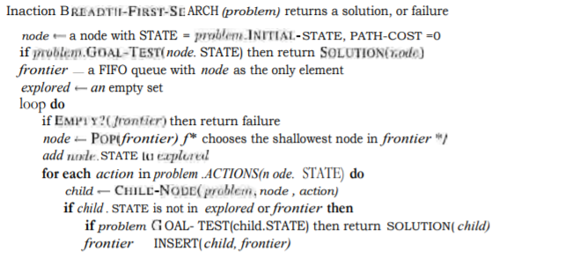
Breadth First Search (continued..)
Algorithm:

Slide 7
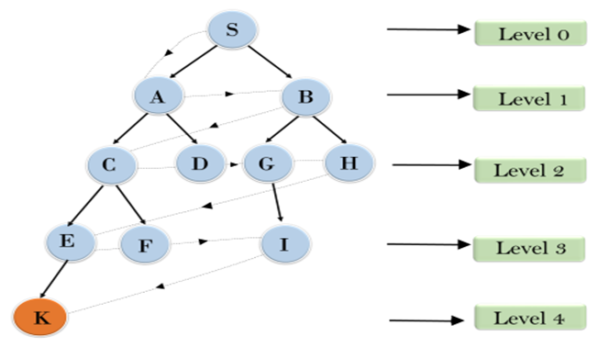
S---> A--->B---->C--->D---->G--->H--->E---->F----> I---->K
Breadth First Search (continued..)
Example:

Slide 8
Breadth First Search (continued..)
Time Complexity:
Time Complexity of BFS algorithm can be obtained by the number of nodes traversed in BFS until the shallowest Node.
Suppose d= depth of shallowest solution and b = branching factor
T (b) = b+b²+b³+.......+ b^{d}= O (b^{d})
Space Complexity:
Every node generated remains in memory. There will be 0(b^{d-1}) nodes in the explored set and O(b^{d}) nodes in the frontier.
So the space complexity is O(b^{d}), i.e., it is dominated by the size of the frontier.

Slide 9
Breadth First Search (continued..)
Completeness:
BFS is complete, which means if the shallowest goal node is at some finite depth, then BFS will find a solution.
Optimality:
BFS is optimal if path cost is a non-decreasing function of the depth of the node.

Slide 10
Breadth First Search (continued..)
Advantages:
BFS will provide a solution if any solution exists.
If there are more than one solutions for a given problem, then BFS will provide the minimal solution which requires the least number of steps.
Disadvantages:
It requires lots of memory since each level of the tree must be saved into memory to expand the next level.
BFS needs lots of time if the solution is far away from the root node.

Slide 11
Water Jug Problem
The state space for this problem can be described as the set of ordered pairs of integers (x,y) such that
x = 0, 1,2, 3 or 4
y = 0,1,2 or 3;
x represents the number of gallons of water in the 4-gallon jug.
y represents the quantity of water in 3-gallon jug.
The start state is (0,0).
The goal state is (2,y).

Slide 12
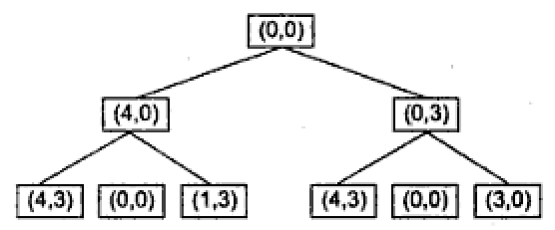
A Partial Search Tree for the Water jug Problem:

Slide 13
Production rules for Water Jug Problem
The operators to be used to solve the problem can be described as follows:
Sl No | Current state | Next State | Descritpion
1 | (x, y) if x < 4 | (4,y) | Fill the 4 gallon jug
2 | (x,y) if y <3 | (x,3) | Fill the 3 gallon jug
3 | (x, y) if x > 0 | (x-d, y) | Pour some water out of the 4 gallon jug
4 | (x, y) if y > 0 | (x, y-d) | Pour some water out of the 3-gallon jug
5 | (x, y) if x>0 | (0, y) | Empty the 4 gallon jug
6 | (x, y) if y >0 | (x,0) | Empty the 3 gallon jug on the ground

Slide 14
7 | (x,y) if x+y >= 4 and y >0 | (4, y-(4-x)) | Pour water from the 3 –gallon jug into the 4 –gallon jug until the 4-gallon jug is full
8 | (x, y) if x+y >= 3 and x>0 | (x-(3-y), 3) | Pour water from the 4-gallon jug into the 3-gallon jug until the 3-gallon jug is full
9 | (x, y) if x+y <=4 and y>0 | (x+y, 0) | Pour all the water from the 3-gallon jug into the 4-gallon jug
10 | (x, y) if x+y <= 3 and x>0 | (0, x+y) | Pour all the water from the 4-gallon jug into the 3-gallon jug

Slide 15
Solution to the water jug problem:
Gallons in the 4-gallon jug | Gallons in the 3-gallon jug | Rule applied
0 | 0 | 2
0 | 3 | 9
3 | 0 | 2
3 | 3 | 7
4 | 2 | 5
0 | 2 | 9
2 | 0

Slide 16
Depth First Search
Depth-first search is a Backtracking technique for finding all possible solutions using recursion algorithm for traversing a tree or graph data structure.
It is called the depth-first search because it starts from the root node and follows each path to its greatest depth node before moving to the next path.
DFS uses a LIFO queue for its implementation.

Slide 17
Depth First Search(continued….)
Algorithm:
1. If the initial state is a goal state, quit and return success.
2. Otherwise, do the following until success or failure is signaled:
Generate a successor, E, of initial state. If there are no more successors, signal failure.
Call Depth-First Search, with E as the initial state
If success is returned, signal success. Otherwise continue in this loop.

Slide 18
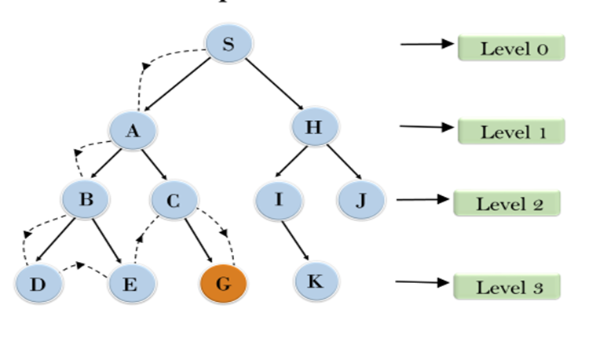
Depth First Search(continued….)
Example:
S---> A--->B---->D--->E---->C--->G

Slide 19
Depth First Search(continued….)
Completeness: DFS search algorithm is complete within finite state space as it will expand every node within a limited search tree.
Time Complexity: Time complexity of DFS will be equivalent to the node traversed by the algorithm. It is given by:
T(n)= 1+b²+ b³ +.........+ b^{m}=O(b^{m})
Where, m= maximum depth of any node and this can be much larger than d (Shallowest solution depth)
Space Complexity: DFS algorithm needs to store only single path from the root node, hence space complexity of DFS is equivalent to the size of the fringe set, which is O(bm).
Optimality: DFS search algorithm is non-optimal, as it may generate a large number of steps or high cost to reach to the goal node.

Slide 20
Depth First Search(continued….)
Advantages:
DFS requires very less memory as it only needs to store a stack of the nodes on the path from root node to the current node.
It takes less time to reach to the goal node than BFS algorithm (if it traverses in the right path).
Disadvantages:
There is the possibility that many states keep re-occurring, and there is no guarantee of finding the solution.
DFS algorithm goes for deep down searching and sometime it may go to the infinite loop.

Slide 21
Depth-Limited Search
A depth-limited search algorithm is similar to depth-first search with a predetermined limit.
Depth-limited search can solve the drawback of the infinite path in the Depth-first search.
In this algorithm, the node at the depth limit will treat as it has no successor nodes further.

Slide 22
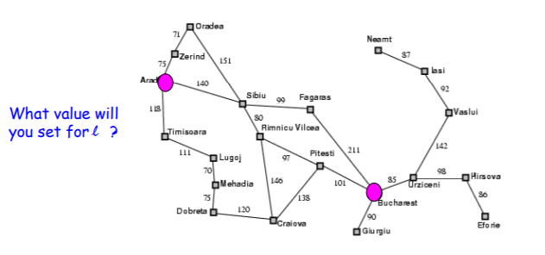
Some times Depth limit can be set based on knowledge of the problem

Slide 23
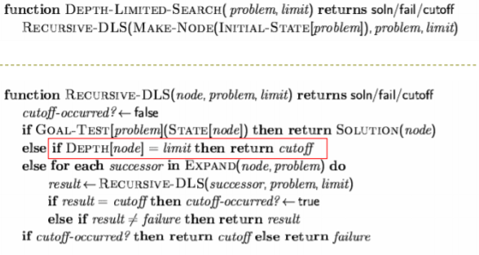
Depth-Limited Search(continued….)
Algorithm:

Slide 24
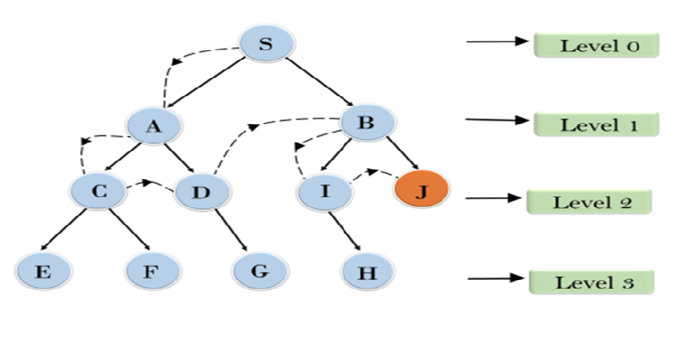
Depth Limited Search(continued…)
Example:

Slide 25
Depth Limited Search(continued…)
Completeness: DLS search algorithm is complete if the solution is above the depth-limit.
Time Complexity: Time complexity of DLS algorithm is O(b^{ℓ}). (where ℓ is the depth limit of the search).
Space Complexity: Space complexity of DLS algorithm is O(b×ℓ).
Optimal: Depth-limited search can be viewed as a special case of DFS, and it is also not optimal, if ℓ>d.

Slide 26
Depth Limited Search(continued…)
Advantages:
Depth-limited search is Memory efficient.
Disadvantages:
Depth-limited search also has a disadvantage of incompleteness.
It may not be optimal if the problem has more than one solution.

